Slide 1

Accelerated Multi-reference Alignment
Szu-Chi Chung
Institute of Statistical Science, Academia Sinica

Slide 2
NCHC Virtual GPU Hackathon (10/5~10/15 from 8:45 AM National Standard Time)
Event introduction and team/mentor call on 9/21(Mon. 2:00pm~5:00pm)
Using Microsoft Teams
Team/Mentor introductions
Introduction to TWCC
Discuss code(s) our team will be working on (give code access where appropriate)
Assign any action items based on discussions
Hackathon Compute System - Taiwan Computing Cloud
10/5 (Mon.) – Introduction and Profiling (9:00am~5:00pm)
Install and tutorial on Nsignt for profiling (9:00am~10:30am)
Each team give a short (2 minutes / 2 slides) presentation including an introduction of your team members and description of your application.
Another short presentation session (3 minutes/3 slides) where teams will share a profile of their codes (showing compute-intensive regions), and the goals for the week (parts of your code you will be targeting, anticipated speedup, intended programming model - OpenACC, CUDA, etc.).
Notes:
National Center for High-Performance Computing
Taiwan Time

Slide 3
NCHC Virtual GPU Hackathon (10/5~10/15 from 8:45 AM National Standard Time)
Morning Updates (Scrum Sessions)
On 10/13 (Tue.), 10/14 and 10/15, each team will give a short (3 minute / 2-3 slides) update (9:00am~10:00am), including
Progress made since last update
Goals for the day
Problems we are currently facing
Problems we have resolved (that other teams might find useful)
On 10/15 (Thur.) afternoon, the teams will finish up development work and give a final presentation (5-7 minutes / 5-7 slides) (3:00pm~5:00pm)
Accomplishments
Issues they ran into, how to resolve them,
Speedups we obtained
Closing thoughts on the event and what we learned.
Notes:
In addition to sharing your progress, these updates are opportunities to get feedback from other teams and mentors. There is a chance that a problem you are facing has already been encountered and resolved by someone else

Slide 4
TWCC
https://www.twcc.ai/doc?page=price
https://tw.openrobot.org/article/index?sn=11700

Slide 5

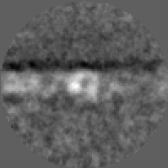
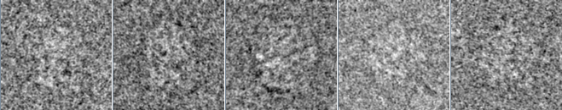
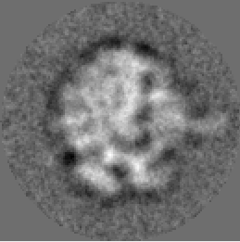
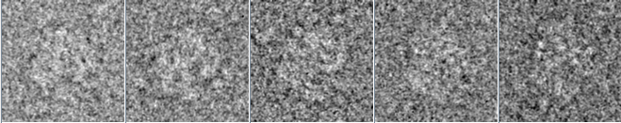
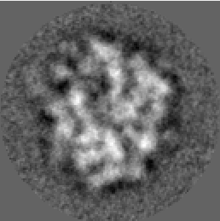
Cryo-EM Image Processing
Alignment and Clustering

Slide 6
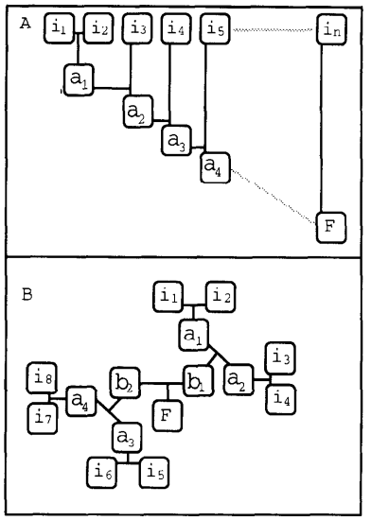
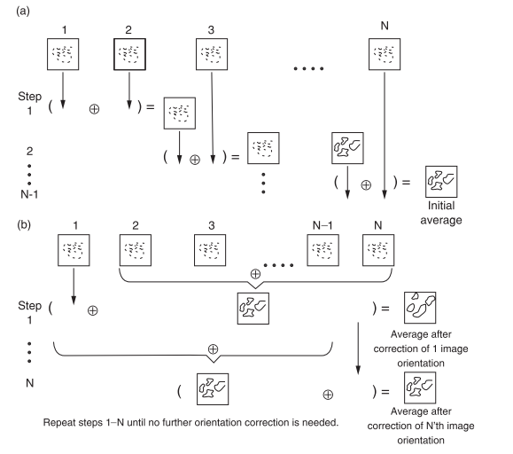
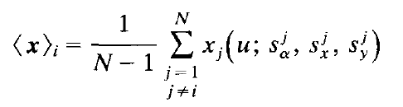
Reference-free alignment [1]
Single Reference
Minimize
Maximizing
where
Notes:
Kmeans criterion
Random approximation of the global average is found
Global average is improved by individually aligning images using the current average as a template

Slide 7
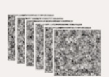



Reference-free alignment [1]
Fast reference-free alignment [2]
Maximum likelihood alignment [3,4]
Fuzzy estimate of latent variable
Model parameters are calculated using weighted averages over all possible latent variables
Particle images
Max ${CC}_{j}$
$${CC}_{1}$$
$${CC}_{2}$$
$${CC}_{3}$$
$${CC}_{4}$$
$${CC}_{5}$$
…
average
Orientation parameters
Calculate CC in
different $(φ,x,y)$

Slide 8
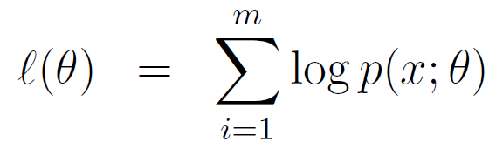
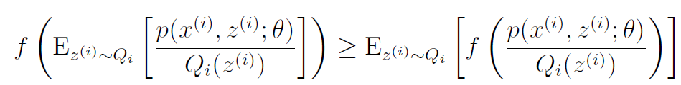
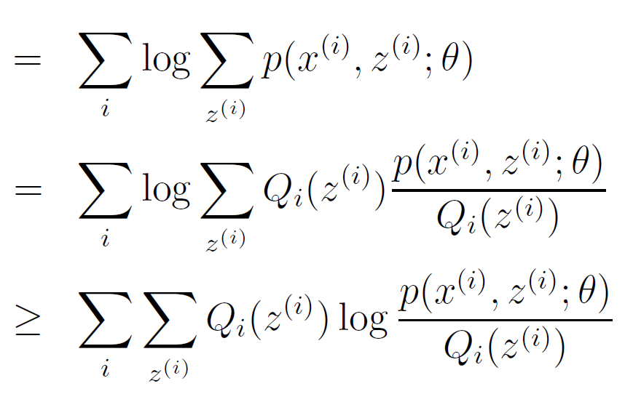
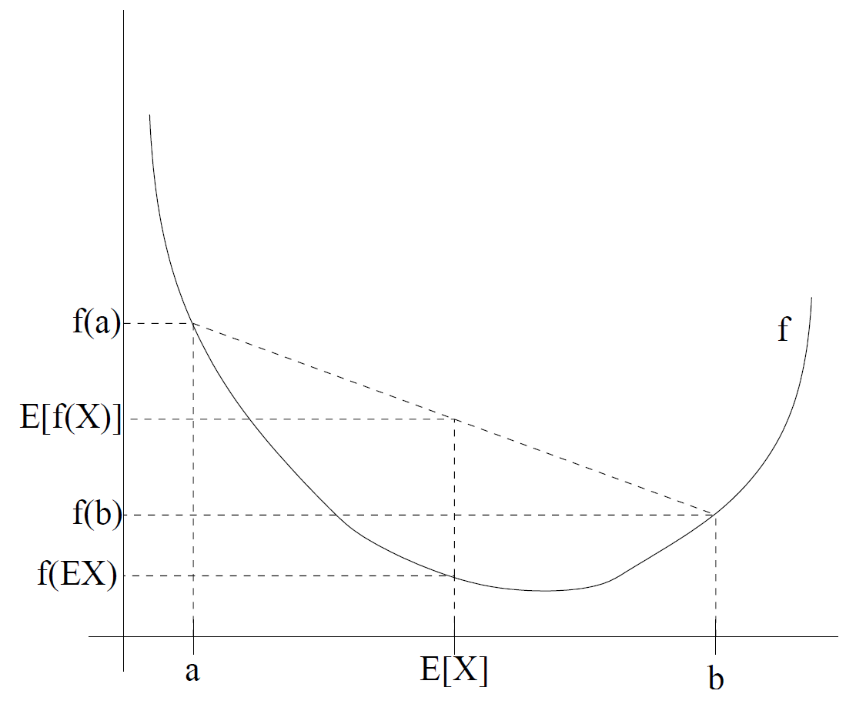
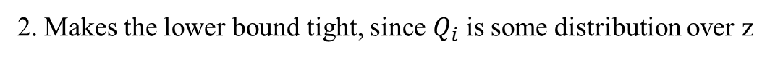
Expectation Maximization Algorithm [5]
Jensen's inequality
1.
2. Makes the lower bound tight, since $Q_{i}$ is some distribution over z
Equality holds when X is constant
Notes:
Fill the missing value and makes it easier to calculate
Qi is some distribution over z
f(x) = logx is a concave functionJensen's inequality,

Slide 9
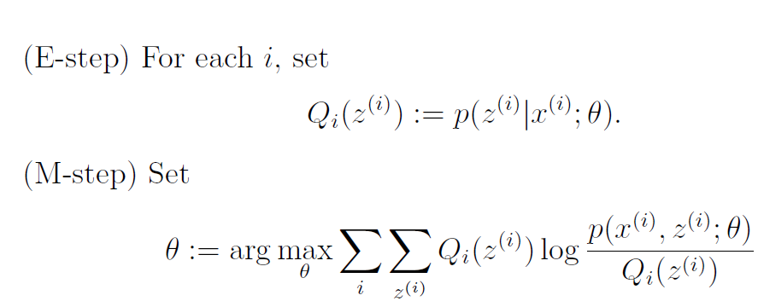
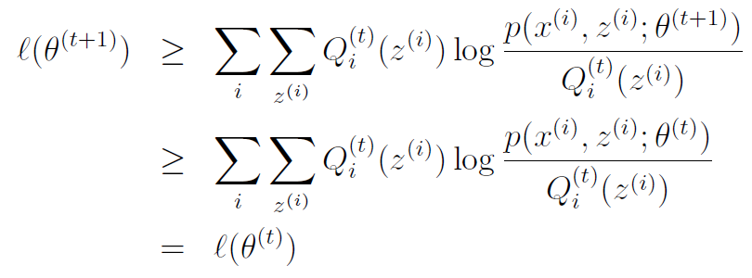
Expectation Maximization Algorithm [5]
Procedure
The likelihood is increased in each iteration

Slide 10





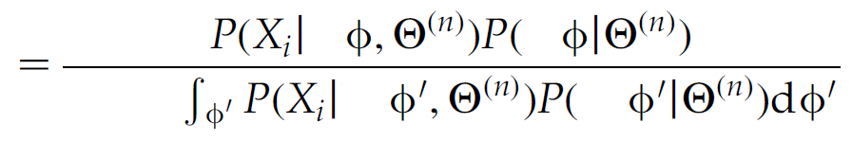

Expectation Maximization Algorithm in CryoEM [4]
Reference-free alignment
E-step
M-step
Notes:
J pixels

Slide 11


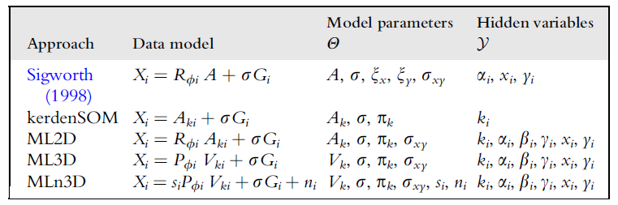





Reference-based alignment
Multireferece alignment [2]
Maximum likelihood, RELION [4,6]
Maximum posterior in maximization step
Particle images
Max ${CC}_{j}$
$${CC}_{1}$$
$${CC}_{2}$$
$${CC}_{3}$$
$${CC}_{4}$$
$${CC}_{5}$$
…
$$+\ln{p(θ)}$$
Orientation parameters and class assignments $k$
Calculate CC in
different $(φ,x,y)$
2D Reference

Slide 12
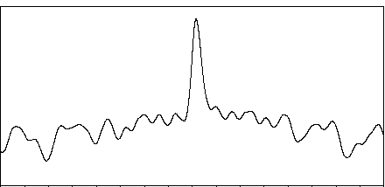
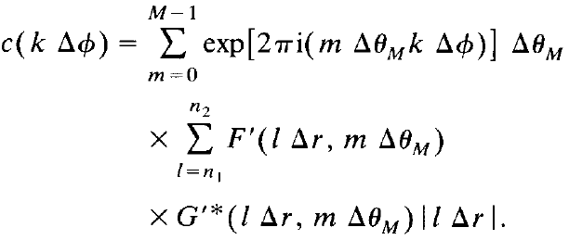


Aligment Step [1,8,9]
$$c$$
Resample to polar coordinate (RPC)
Translational is exhaustive search (CPU)
Resample to polar coordinates (GPU kernel)
Apply FFT (cufft)
Calculate CCF (gpu_aln_noref.cu#691) (GPU kernel)
Rotational cross-correlation function
Apply IFFT(cufft)
$$Φ$$
Convolution theorem

Slide 13
Example: Iterative Stable Alignment and Clustering (ISAC) [7]
Stability check
2D alignment is stable if perturbation of initial alignment parameters does not produce dramatically different results
Postulate that alignment stability of a group of images is equal to homogeneity
Define a cost function and optimize to find a subset of stable images within the cluster
Using L runs of reference-free alignment
Notes:
Each iteration of reference-free alignment is completed with an update of the global average using the alignment parameters found.
Initialize the algorithm by setting rotation angles and a mirroring flag to random values and translations to zero

Slide 14
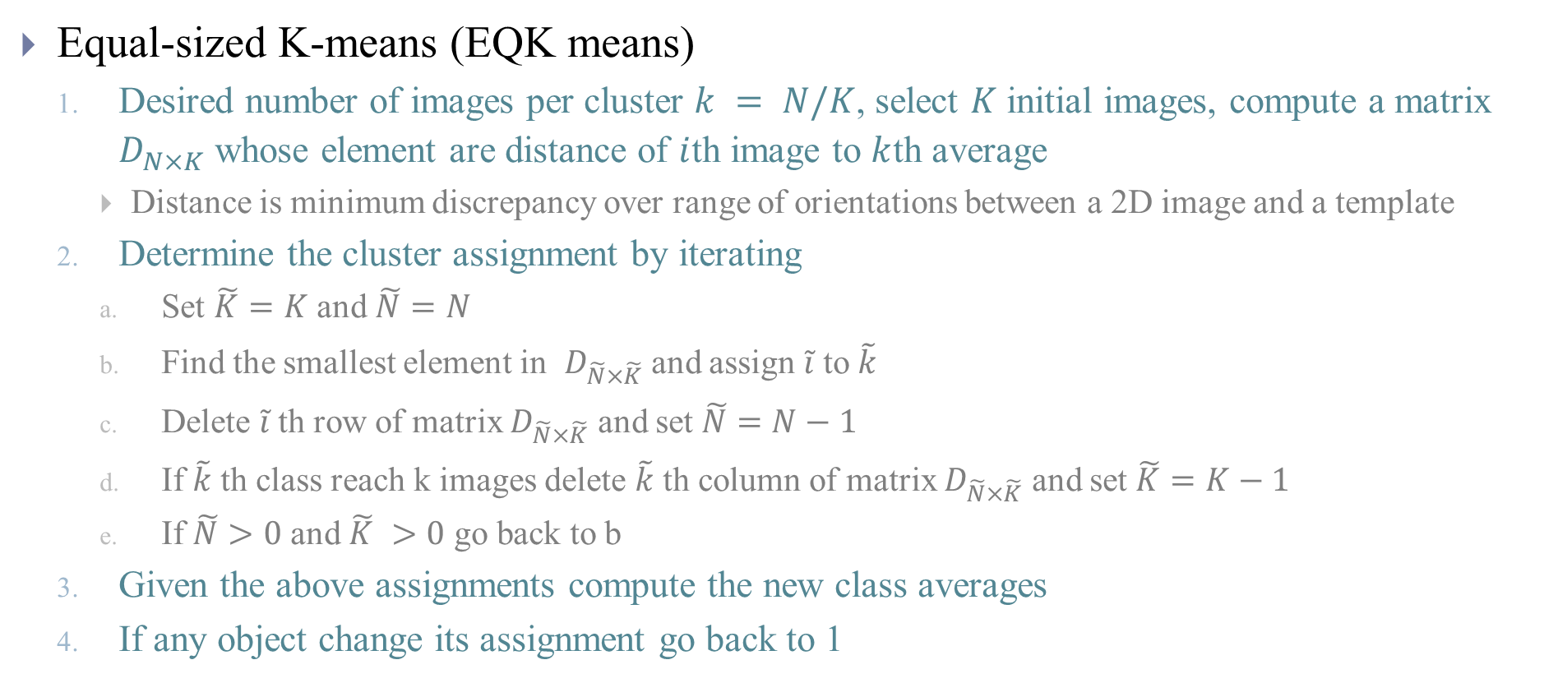
Example: Iterative Stable Alignment and Clustering (ISAC)
Equal-sized K-means (EQK means)
Desired number of images per cluster $k = N/K$, select $K$ initial images, compute a matrix $D_{N×K}^{}$ whose element are distance of $i$th image to $k$th average
Distance is minimum discrepancy over range of orientations between a 2D image and a template
Determine the cluster assignment by iterating
Set $\tilde{K}=K$ and $\tilde{N}=N$
Find the smallest element in $D_{\tilde{N}×\tilde{K}}^{}$ and assign $\tilde{i}$ to $\tilde{k}$
Delete $\tilde{i}$th row of matrix $D_{\tilde{N}×\tilde{K}}^{}$ and set $\tilde{N}=N−1$
If $\tilde{k}$ th class reach k images delete $\tilde{k}$ th column of matrix $D_{\tilde{N}×\tilde{K}}^{}$ and set $\tilde{K}=K−1$
If $\tilde{N}>0$ and $\tilde{K} >0$ go back to b
Given the above assignments compute the new class averages
If any object change its assignment go back to 1

Slide 15
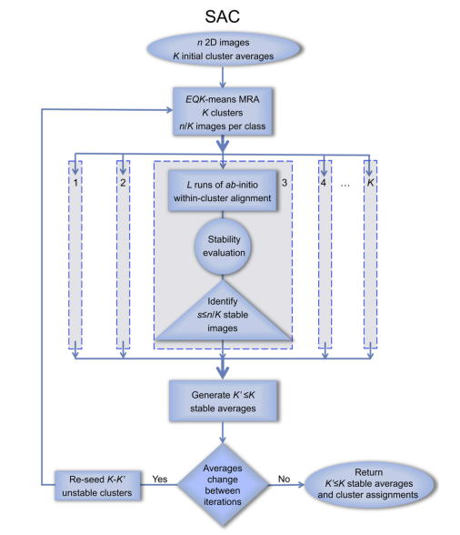
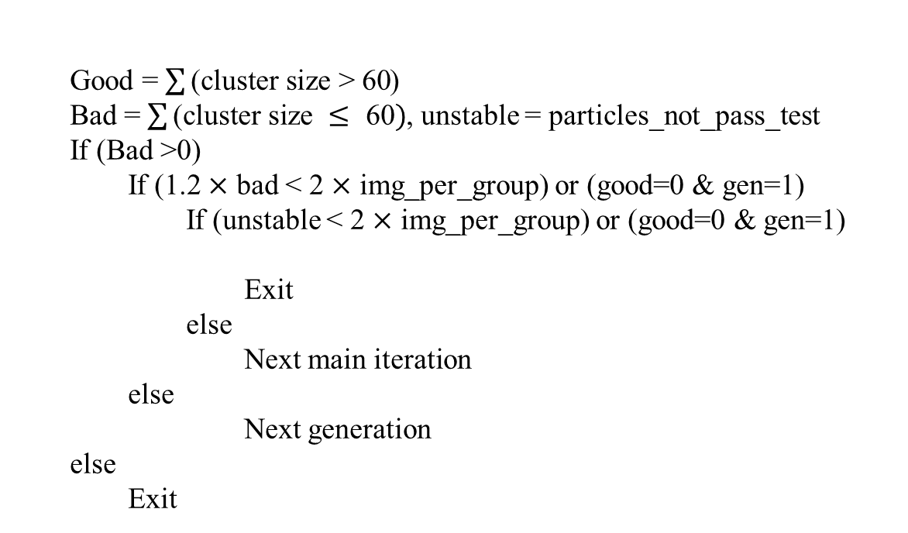
Example: Iterative Stable Alignment and Clustering (ISAC)
Reference-free alignment
Stability: Alignment parameters
Evaluation using mirror stability and orientation stability
Find a subset that is stable in each cluster
Terminate condition
MRA+EQK means
Good = $\sum{\text{(}\text{cluster} \text{size}\text{ > 60}}$)
Bad = $\sum{\text{(}\text{cluster} \text{size} ≤\text{ 60})}$, unstable = particles_not_pass_test
If (Bad >0)
If (1.2 $×$ bad < 2 $×$ img_per_group) or (good=0 & gen=1)
If (unstable < 2 $×$ img_per_group) or (good=0 & gen=1)
Exit
else
Next main iteration
else
Next generation
else
Exit

Slide 16
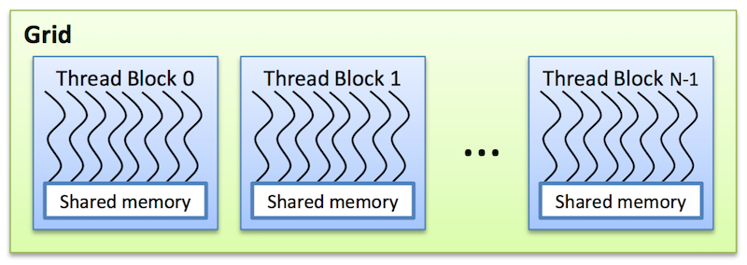



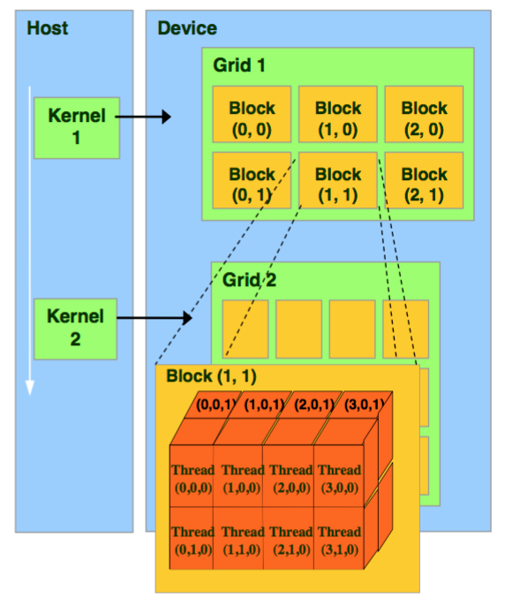
Implementation: MPI and CUDA
Amdahl's law
MPI (Message Passing Interface)
Solution for distributed system
Parallelize in single node
OpenMP
Cuda
OpenCL
…
Notes:
Shared memory multiprocessing programming
These are read-only memory spaces accessible by all threads.
Constant memory is used to cache values that are shared by all functional units
Texture memory is optimized for texturing operations provided by the hardware

Slide 17
1. MPI with single GPU (Parallelize for images)
reference-free alignment (sxisac2_gpu #1281- application.ali2d_base_gpu_isac_CLEAN)
#----------------------------------[gpu setup]--------------------------------
# alignment parameters
aln_cfg = AlignConfig( len(data), 1, # no. of images & averages data[0].get_xsize(),
numr[-3], 256, # polar sampling (no. of rings, no. of sample on ring)
step[0], xrng[0], xrng[0]) # shift step size & shift range in x/y dim)
aln_cfg.freeze() #
#find largest batch size we can fit on the given card
gpu_batch_limit = 0
for split in [ 2**i for i in range(int(math.log(len(data),2))+1) ][::-1]: aln_cfg.sbj_num = min( gpu_batch_limit + split, len(data) )
if cu_module.pre_align_size_check(…) == True:
gpu_batch_limit += split
gpu_batch_limit = aln_cfg.sbj_num
# initialize gpu resources (returns location for our alignment parameters in CUDA unified memory)
gpu_aln_param = cu_module.pre_align_init( … )
gpu_batch_count = len(data)/gpu_batch_limit …
# if the local stack fits on the gpu we only fetch the img data once before we loop if( gpu_batch_count == 1 ):
cu_module.pre_align_fetch( get_c_ptr_array(data), ctypes.c_uint(len(data)), ctypes.c_char_p("sbj_batch") )
# MPI Parallelize - determine global index values of particles handled by this process
image_start, image_end = MPI_start_end(total_nima, number_of_proc, myid)
list_of_particles = list_of_particles[image_start:image_end]
# set default value for the last ring if none given
if last_ring == -1: last_ring = nx/2-2
mask = util.model_circle(last_ring, nx, nx)
cny = cnx = nx/2+1 # image center
mode = "F"
# precalculate rings & weights
numr = alignment.Numrinit( first_ring, last_ring, rstep, mode )
wr = alignment.ringwe( numr, mode )

Slide 18
1. MPI with single GPU
ref_data = [mask, center, None, None]
for N_step in range(len(xrng)):
# set gpu search parameters
cu_module.reset_shifts(…)
for Iter in range(max_iter):
total_iter += 1
#1. --------------[ construct new average ]-------------------
# sum up the original images
ave1, ave2 = statistics.sum_oe( data, "a", CTF, EMData() ) util.reduce_EMData_to_root(ave1, myid, main_node, comm=mpi_comm)
util.reduce_EMData_to_root(ave2, myid, main_node, comm=mpi_comm)
if myid == main_node: # log iteration info
tavg = (ave1+ave2)/total_nima
frsc = statistics.fsc_mask(ave1, ave2, mask, 1.0)
else:
tavg = util.model_blank(nx, nx)
# main node applies (optional) fourier transform and user function (center and filtering)
if myid == main_node:
a1 = tavg.cmp("dot", tavg, dict(negative=0, mask=ref_data[0]) )
msg = "Criterion %d = %15.8e"%(total_iter, a1)
ref_data[2] = tavg
ref_data[3] = frsc
# centering (default: average centering method)
…
# write the current filtered average
if outdir:
tavg.write_image(os.path.join(outdir, "aqf.hdf"), total_iter-1)
# update abort criterion
# check for abort
#2.-----------------------[ alignment ] -----------------------
# broadcast the newly constructed average to everyone util.bcast_EMData_to_all(tavg, myid, main_node, comm=mpi_comm)
…
# transfer latest average to gpu cu_module.pre_align_fetch( get_c_ptr_array([tavg]), ctypes.c_int(1), ctypes.c_char_p("ref_batch") ) # NOTE: happens for each shift change
# FOR gpu_batch_i DO ~ ~ ~ ~ ~ ~ ~ ~ ~ ~ ~ ~ ~ ~ ~ >
for gpu_batch_idx in range(gpu_batch_count):
# determine next gpu batch and shove to the gpu
if( gpu_batch_count > 1 ):
gpu_batch_start = gpu_batch_idx * gpu_batch_limit
gpu_batch_end = gpu_batch_start + gpu_batch_limit
if gpu_batch_end > len(data): gpu_batch_end = len(data) cu_module.pre_align_fetch( … )
else:
gpu_batch_start = 0
gpu_batch_end = len(data)
# run the alignment on gpu
cu_module.pre_align_run(…)
# convert alignment parameters to the format expected by other sphire
…
# free gpu resources
cu_module.gpu_clear()
mpi.mpi_barrier(mpi_comm)
Notes:
# sum_oe returns sum of [o]dd and [e]ven items
# a0 should increase; stop algorithm when it decreases.
# However, the result will depend on filtration, so it is not quite right
# NOTE: total_iter is incremented at the start of the loop, the last iteration does not do an alignment # backup last iteration's alignment parameters

Slide 19
2. MPI with multiple GPU (Parallelize for images and references)
Mutigroup reference-free alignment(sxisac2_gpu#1083-applications.multigroup_refinement_gpu)
# GPU class limit (memtest)
global GPU_CLASS_LIMIT
if myid==0:
l = applications.multigroup_refinement_gpu_fit_max( (Blockdata["total_nima"]//options.minimum_grp_size+1)//(len(GPU_DEVICES)+1), …) GPU_CLASS_LIMIT = l[1]
print( … "main() :: Each GPU holds "+str(GPU_CLASS_LIMIT)+" classes for stability testing.")
# GPU process communicator
global MPI_GPU_COMM MPI_GPU_COMM = mpi.mpi_comm_split( mpi.MPI_COMM_WORLD, (Blockdata["myid_on_node"] in GPU_DEVICES), myid )
# batch size of input reads per GPU proc
batch_mem_avl = (sys_mem_avl*sys_mem_use - data_size_sub) / len(GPU_DEVICES)
batch_img_num = int( batch_mem_avl / (data_size_raw/Blockdata["total_nima"]) )
# alignment configuration
aln_cfg = AlignConfig( 0, 0, img_dim, # No. of images, No. of references, and image size outer_polar_radius, 256, # polar sampling parameters (No. of rings, No. of ring elements)
1, shift_rng_x, shift_rng_y) # shift parameters (step, shift ranges in x/y dimension) aln_cfg.freeze()
# perform binary search to determine maximum work load
gpu_class_limit = 0
for split in [ 2**i for i in range(int(math.log(max_class_num,2))+1) ][::-1]:
aln_cfg.ref_num = min( gpu_class_limit+split, max_class_num )
aln_cfg.sbj_num = aln_cfg.ref_num * max_class_size
if cu_module.ref_free_alignment_2D_size_check(…) == True:
gpu_class_limit += split

Slide 20
2. MPI with multiple GPU
#-------------- [ initialize gpu resources ] ---------------------
# alignment parameters
aln_cfg = AlignConfig( len(sbj_img_list), # no. of images
sbj_cid_list[-1]+1, # no. of references
sbj_img_list[0].get_xsize(), # image size
outer_polar_radius, 256, # polar sampling parameters (no. of rings, no. of ring elements)
1., shift_rng_x, shift_rng_y) # shift parameters (step size, shift ranges in x/y dimension)
aln_cfg.freeze()
# build the class index (cid_idx) list
cid_idx = np.append( np.where(np.roll(sbj_cid_list, 1) != sbj_cid_list)[0], len(sbj_cid_list) ) …
# randomize alignment angles (in ISAC this flag is hardcoded and always True)
…
# build the initial averages (takes into account any existing shifts)
avg_img_list = [ statistics.ave_series( sbj_img_list[cid_idx[k]:cid_idx[k+1]] ) for k in range( len(cid_idx)-1 ) ]
# initialize gpu resources (returns location for our alignment parameters in CUDA unified memory)
aln_param = cu_module.ref_free_alignment_2D_init(…)
…
#----------------[ run alignment iterations ]
for i in range(num_iter): # filter
if cutoff_freq > 0.0:
freq = 0.1 + (cutoff_freq-0.1)*i / float(num_iter-1)
cu_module.ref_free_alignment_2D_filter_references( ctypes.c_float(freq), ctypes.c_float(falloff) ) # run refinement iteration on the GPU
cu_module.ref_free_alignment_2D()
#---------------[ export alignment parameters ]
# convert alignment parameters to the format by ave_series() (CPU ISAC does this at the end of
…
# NOTE: writing the header is what this function returns
# free gpu resources
cu_module.gpu_clear()

Slide 21
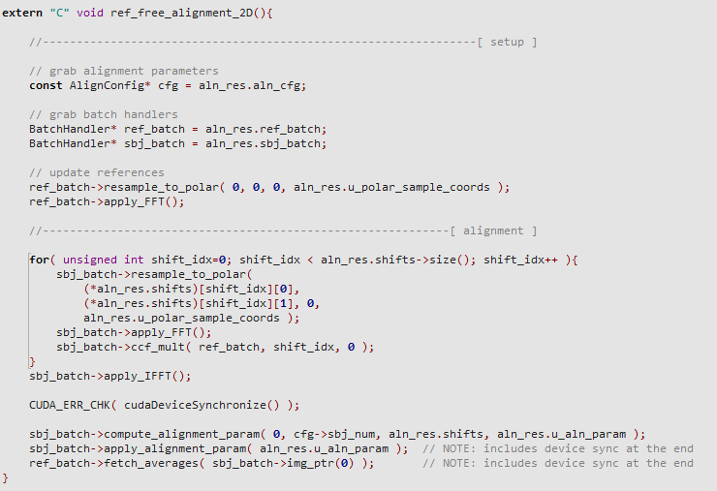
3. CUDA kernel

Slide 22
Action Items
Trace the code of reference-free alignment (sxisac2_gpu#1281 application.ali2d_base_gpu_isac_CLEAN)
Trace the code of Mutigroup reference-free alignment(sxisac2_gpu#1083 applications.multigroup_refinement_gpu)
Trace the code of Multireference alignment (sxisac2_gpu#777 Util.multiref_polar_ali_2d_peaklist)
Create small example with little dependency to call these routines

Slide 23
References
[1] Penczek, Pawel, Michael Radermacher, and Joachim Frank. "Three-dimensional reconstruction of single particles embedded in ice." Ultramicroscopy 40.1 (1992): 33-53.
[2] https://sphire.mpg.de/wiki/doku.php?id=gpu_isac
[3] Sigworth, Fred J. "A maximum-likelihood approach to single-particle image refinement." Journal of structural biology 122.3 (1998): 328-339.
[4] Sigworth, Fred J., et al. "An introduction to maximum-likelihood methods in cryo-EM." Methods in enzymology. Vol. 482. Academic Press, 2010. 263-294.
[5] http://cs229.stanford.edu/notes/cs229-notes8.pdf
[6] Scheres, Sjors HW. "RELION: implementation of a Bayesian approach to cryo-EM structure determination." Journal of structural biology 180.3 (2012): 519-530.
[7] Yang, Zhengfan, et al. "Iterative stable alignment and clustering of 2D transmission electron microscope images." Structure 20.2 (2012): 237-247.
[8] Joyeux, Laurent, and Pawel A. Penczek. "Efficiency of 2D alignment methods." Ultramicroscopy 92.2 (2002): 33-46.
[9] Cong, Yao, Julio A. Kovacs, and Willy Wriggers. "2D fast rotational matching for image processing of biophysical data." Journal of structural biology 144.1-2 (2003): 51-60.

